Slide 1
COMPUTER VISION FOR HUMAN INTERACTION
Thanuja Maddali

Slide 2
INTRODUCTION
Human-computer interaction (HCI) is evolving rapidly with the aim of more natural communication between humans and computers.
Traditional input devices lack flexibility, prompting the need for natural interfaces like voice commands and body language.
Computer vision for human Interaction(CVHI) is all about making interactions between humans and machines feel more natural and intuitive.
CVHI is like teaching computers to see and understand human gestures,Expressions,and Movements,So we can communicate with them more easily.

Slide 3
Applications
Gesture Recognition
Facial Expression Analysis
Object Tracking
Human Pose Estimation
Eye Tracking

Slide 4
ONIHCI MODEL
The ONIHCI (Optimized Noninvasive Human-Computer Interaction) The model is particularly focused on addressing the challenges in the context of computer vision-based HCI and human movement recognition
The ONIHCI model employs a combination of human kinematics analysis and trajectory analysis. It leverages spatial thermographic images, extracting information about human body orientation, including arm, leg, and head regions.
The model aims to provide an optimized and noninvasive approach to accurately recognize and track human targets, essential for effective human-computer interaction.

Slide 5
Case:Human Kinetic Analysis
Objective: Identify humans during movement or static positions using spatial thermographic images.
Approach: Extract frames from thermographic images and compute areas of dynamic targets to analyze trajectories and kinematics.
Targets: Three human targets with specific body orientations around arms, legs, and head are considered.
Motion Direction Determination: Analyze the angle between legs and head to determine the direction of motion.

Slide 6
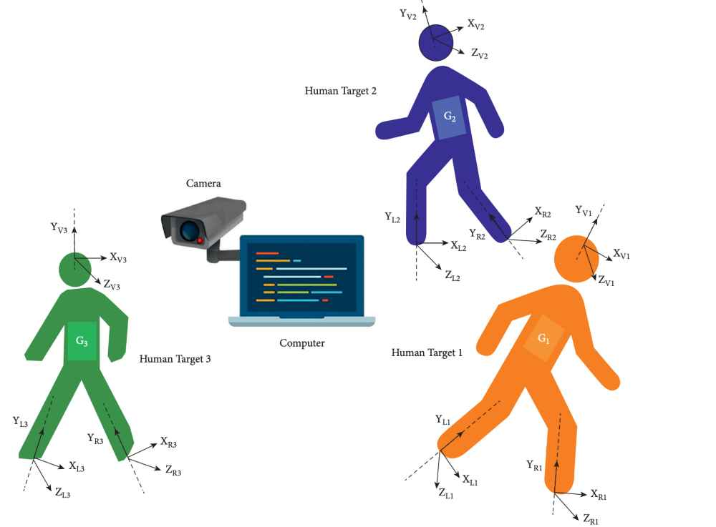
Human Body Kinetic Analysis

Slide 7
EXPERIMENTAL RESULTS
ONIHCI outperforms existing models in human motion recognition, achieving a highest performance ratio of 95.4%.
The model's effectiveness is evident across various datasets, showcasing its superior performance in diverse scenarios.
ONIHCI proves user-friendly compared to command-based systems, offering robust detection and recognition of human targets.
Performance ratios and accuracy metrics consistently position ONIHCI as a highly effective solution for computer vision-based human-computer interaction

Slide 8
ADVANTAGES
Natural Interaction
Enhanced Accesibility
Real time Interaction
Multi Model Interaction
Enhanced User Experience

Slide 9
CHALLENGES AND ISSUES
CVHI systems need to achieve high levels of accuracy and precision, especially in applications where fine details matter.
CVHI systems must be adaptable to diverse environmental conditions, including varying lighting, backgrounds, and user contexts.
The use of computer vision in human interaction raises privacy issues, as it involves capturing and processing visual information.

Slide 10
Conclusion
In summary, the ONIHCI model integrates spatial thermographic analysis and EMG-driven motion recognition to address gesture recognition challenges. Experimental results showcase a robust system with a 97.2% accuracy in human motion recognition, affirming its efficacy for noninvasive human-computer interaction.

Slide 11
References
[1] F. Zhang, T.-Y. Wu, J.-S. Pan, G. Ding, and Z. Li, “Human motion recognition based on SVM in VR art media inter- action environment,” Human-centric Computing and Infor- mation Sciences, vol. 9, no. 1, p. 40, 2019.
[2] N. R. Baek, S. W. Cho, J. H. Koo, N. Q. Truong, and K. R. Park, “Multimodal camera-based gender recognition using human- body image with two-step reconstruction network,” IEEE Access, vol. 7, pp. 104025–104044, 2019.
[3] A. Brunetti, D. Buongiorno, G. F. Trotta, and V. Bevilacqua, “Computer vision and deep learning techniques for pedestrian detection and tracking: a survey,” Neurocomputing, vol. 300, pp. 17–33, 2018
[4] S. Khan, H. Rahmani, S. A. A. Shah, and M. Bennamoun, “A guide to convolutional neural networks for computer vision,” Synthesis Lectures on Computer Vision, vol. 8, no. 1, pp. 1–207, 2018.
[5] J. Qi, G. Jiang, G. Li, Y. Sun, and B. Tao, “Surface EMG hand gesture recognition system based on PCA and GRNN,” Neural Computing & Applications, vol. 32, no. 10, pp. 6343– 6351, 2020.

